Slide 1
Parkinson’s disease detection
Under the Guidance of :-
Dr.Rashmi Chaudhary
Submitted By:-
Aishwarya Muarya (17100003)
Jinendra Malekar (17100019)
Shivam Narware (17100052)

Slide 2
What is Parkinson’s disease
Parkinson's disease (PD) [1], or simply Parkinson's, is a long-term degenerative disorder of the central nervous system that mainly affects the motor system. As the disease worsens, non-motor symptoms become more common.
Parkinson’s disease usually occur to people who are 60 year or older.

Slide 3
Motivation
In 2015, PD affected 6.2 million people and resulted in about 117,400 deaths globally. Parkinson's disease typically occurs in people over the age of 60, of whom about one percent are affected.
There is no cure for Parkinson's disease.
Parkinson’s is the second most common neurodegenerative disorder after Alzheimer's disease and affects approximately seven million people globally.
No specific test exists to diagnose Parkinson's disease.

Slide 4
Exisiting solutions and limitations
Author Name | Paper Name | Solution | Model Used | Limitations of Existing Solution
Timothy J. Wroge, Yasin Özkanca | Parkinson’s Disease Diagnosis Using Machine Learning and Voice[2(a)] | 86% accuracy | Gradient Boosted Decision Tree | Low accuracy,
Akshaya Dinesh, Jennifer He | Using machine learning to diagnose Parkinson's disease from voice recordings[2(b)] | 91.21% accuracy | Boosted Decision tree, Decision tree, SVM, Logistic Regression | Accuracy can be further increased.
Sibel Çimen, Bulent Bolat | Diagnosis of Parkinson's disease by using ANN[2(c)] | 93 % accuracy | General Regression Neural Network | 1)Used only 13 features for prediction 2)Model may be overfit.

Slide 5
Proposed solution
Detection of Parkinson’s disease will take place in following steps:
Taking voice sample from real people in the website.
Using MDVP software we will convert voice sample into numeric features.
Feeding this features to our Machine Learning Algorithm.
Prediction will be done on the basis of these features.
Result will be shown to the user.

Slide 6
Flowchart OF Proposed solution
Audio input
MDVP converter software
Parkinson’s Disease features
Applying ML algorithm
Predict that person is Diseased(Yes/No)?

Slide 7
About the dataset
Dataset – voice recording of 31 people
23 with Parkinson's disease.
Columns- Particular voice measure( Jitter, Shimmer, Frequency).
Row – One of 197 voice recording from these individuals.
Parkinson’s Disease, according to "status" column which is set to 0 for healthy and 1 for Parkinson’s Disease.

Slide 8
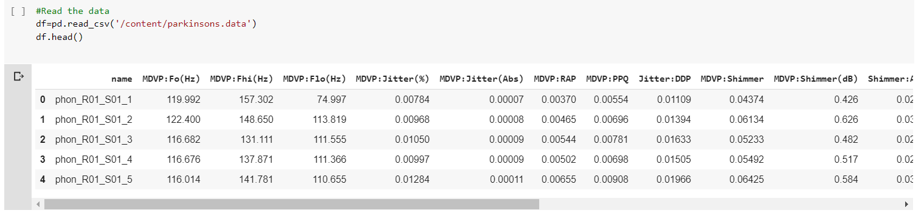
About the dataset
Number of Instances : 197
Number of Attributes: 23

Slide 9
Dataset features
name - ASCII subject name and recording number.
MDVP:Fo(Hz) - Average vocal fundamental frequency.
MDVP:Fhi(Hz) - Maximum vocal fundamental frequency.
MDVP:Flo(Hz) - Minimum vocal fundamental frequency.
MDVP:Jitter(%), MDVP: Jitter(Abs), MDVP:RAP,MDVP:PPQ,Jitter:DDP - Several measures of variation in fundamental frequency.
MDVP:Shimmer,MDVP:Shimmer(dB),Shimmer:APQ3,Shimmer:APQ5,MDVP:APQ,Shimmer:DDA - Several measures of variation in amplitude.
NHR,HNR - Two measures of ratio of noise to tonal components in the voice.
status - Health status of the subject (one) - Parkinson's, (zero) – healthy.
RPDE,D2 - Two nonlinear dynamical complexity measures.
DFA - Signal fractal scaling exponent.
spread1,spread2,PPE - Three nonlinear measures of fundamental frequency variation.

Slide 10
Classification based on properties
Fundamental Voice frequency – Average,Maximum and minimum.
Jitter- Jitter is a measure of frequency instability.
Shimmer - Shimmer is a measure of amplitude instability.
NHR - Noise to Harmonic Ratio(The mean overall NHR increases according to the age group.)

Slide 11
What is XGBoost Algorithm?
XGBoost is a new Machine Learning algorithm designed with speed and performance in mind[3].
XGBoost stands for eXtreme Gradient Boosting and is based on decision trees[3].

Slide 12
Gradient boosting classifiers
Gradient boosting classifiers are a group of machine learning algorithms that combine many weak learning models together to create a strong predictive model[4].
It is called gradient boosting because it uses a gradient descent algorithm to minimize the loss when adding new models[4].

Slide 13
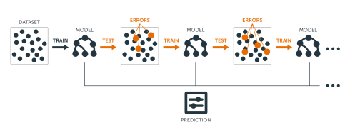
The main idea of boosting is to add new models to the ensemble sequentially.
At each particular iteration, a new weak, base-learner model is trained with respect to the error of the whole ensemble learnt so far.
Fig 1. Sequential ensemble approach[4].

Slide 14
Sequential training with respect to errors: Boosted trees are grown sequentially; each tree is grown using information from previously grown trees.
The basic algorithm for boosted regression trees can be generalized to the following where x represents our features and y represents our response:
1. Fit a decision tree to the data:
F1(x)=y,
2. We then fit the next decision tree to the residuals of the previous:
h1(x)=y−F1(x),
3. Add this new tree to our algorithm:
F2(x)=F1(x)+h1(x)
4. Fit the next decision tree to the residuals of F2F2:
h2(x)=y−F2(x)
5. Add this new tree to our algorithm:
F3(x)=F2(x)+h1(x)),
6. Continue this process until cross validation tells us to stop[4].

Slide 15
Fig 2. Boosted regression tree predictions[5]

Slide 16
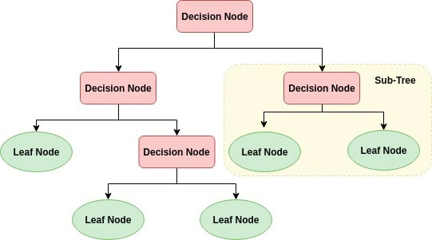
Decision Tree Algorithm
A decision tree is a flowchart-like tree structure where an internal node represents feature(or attribute), the branch represents a decision rule, and each leaf node represents the outcome.
The topmost node in a decision tree is known as the root node.
It learns to partition on the basis of the attribute value.
Fig 3 – Decision Tree[6]

Slide 17
How does the Decision Tree algorithm work?
The basic idea behind any decision tree algorithm is as follows:
Select the best attribute using Attribute Selection Measures(ASM) to split the records.
Attribute Selection Measures
Information Gain
Gain Ratio
Gini index
2. Make that attribute a decision node and breaks the dataset into smaller subsets.
3. Starts tree building by repeating this process recursively for each child until one of the condition will match:
All the tuples belong to the same attribute value.
There are no more remaining attributes.
There are no more instances[7].

Slide 18
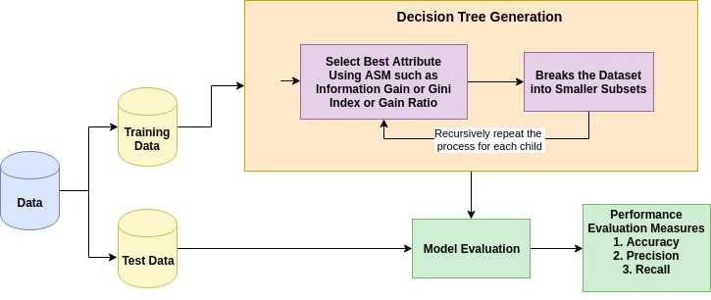
Figure 4-Decision Tree Generation Flowchart[8]

Slide 19
Results
We have trained our model on the basis of XGBoost Algorithm and Random Forest Classifier and the results from the two are:
We got the Accuracy Score of XGBoost : 94.87%
From the Random Forest Accuracy Score are : 92.30%

Slide 20
Future Work
We will try to predict the disease using Neural Network algorithm.
Compare them with our previous observation and use the best model(on the basis of accuracy).
We will try to make a web-based platform and take the inputs of voice and detect whether a person has a Parkinson’s disease.

Slide 21
references
https://en.wikipedia.org/wiki/Parkinson%27s_disease
IEEE Reference Papers:
https://ieeexplore.ieee.org/abstract/document/8615607
https://ieeexplore.ieee.org/document/8284216
https://ieeexplore.ieee.org/document/7955281
https://data-flair.training/blogs/python-machine-learning-project-detecting-parkinson-disease/
http://uc-r.github.io/gbm_regression
http://uc-r.github.io/public/images/analytics/gbm/boosted-trees-process.png
https://res.cloudinary.com/dyd911kmh/image/upload/f_auto,q_auto:best/v1545934190/1_r5ikdb.png
https://www.datacamp.com/community/tutorials/decision-tree-classification-python
https://res.cloudinary.com/dyd911kmh/image/upload/f_auto,q_auto:best/v1545934190/2_btay8n.png

